Slide 1
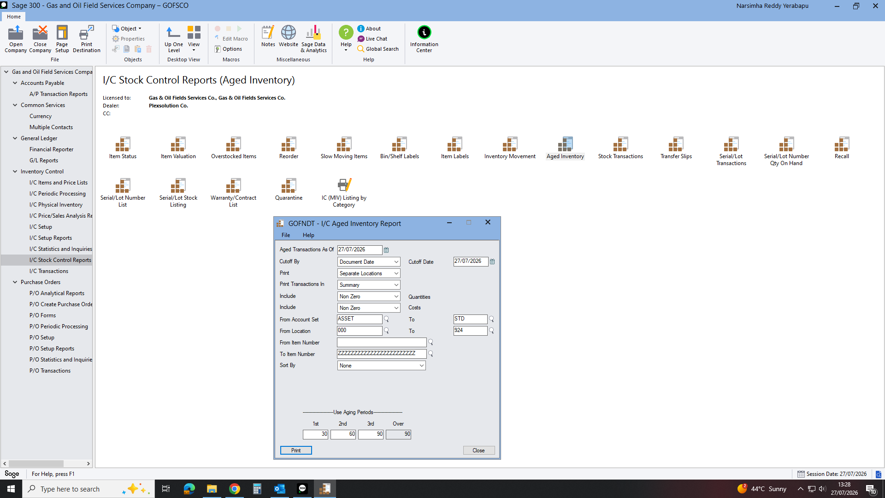
Notes:
TO GET AGED INVENTORY CAN GET DEPARTMENTS WISE TOTAL STOCK AND TOTAL VALU ONE TIME ALL DEPARTMENTS. INVENTORY CONTROL: I/C STOCK CONTROL REPORTS THEN AGED INVENTORY AND FILL ALL THE DETAILS THEN CLICK PRINT. WILL GET REPORT AS BELOW.

Slide 2
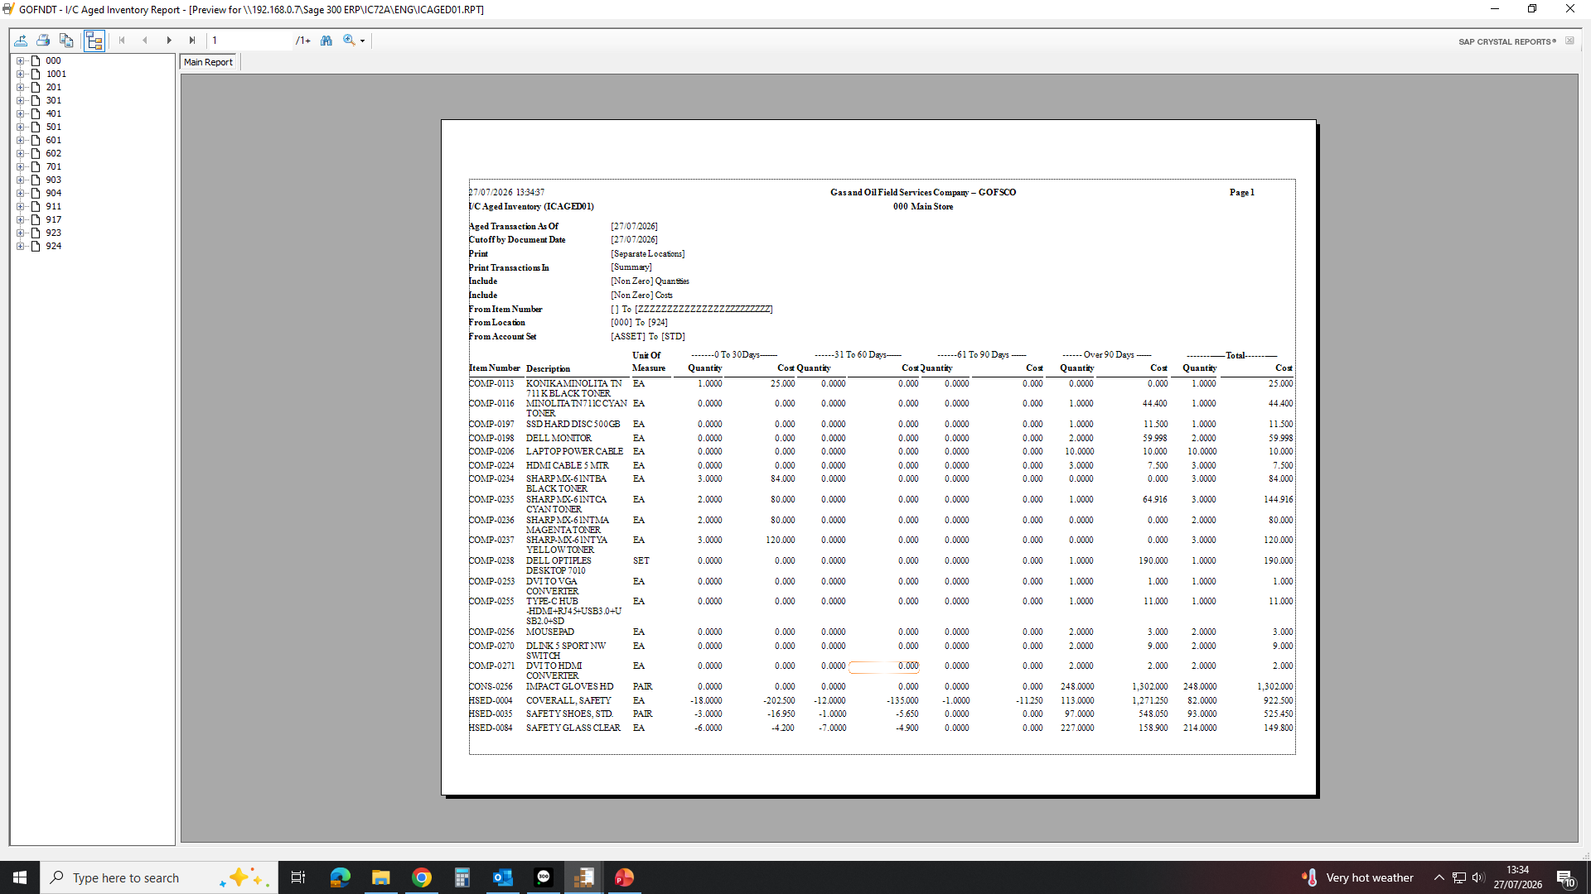
WILL GET CLEARLY DEPARTMENT WISE. THEN EXPORT TO EXCEL AND ORGANISE AS NEEDED

